Slide 1
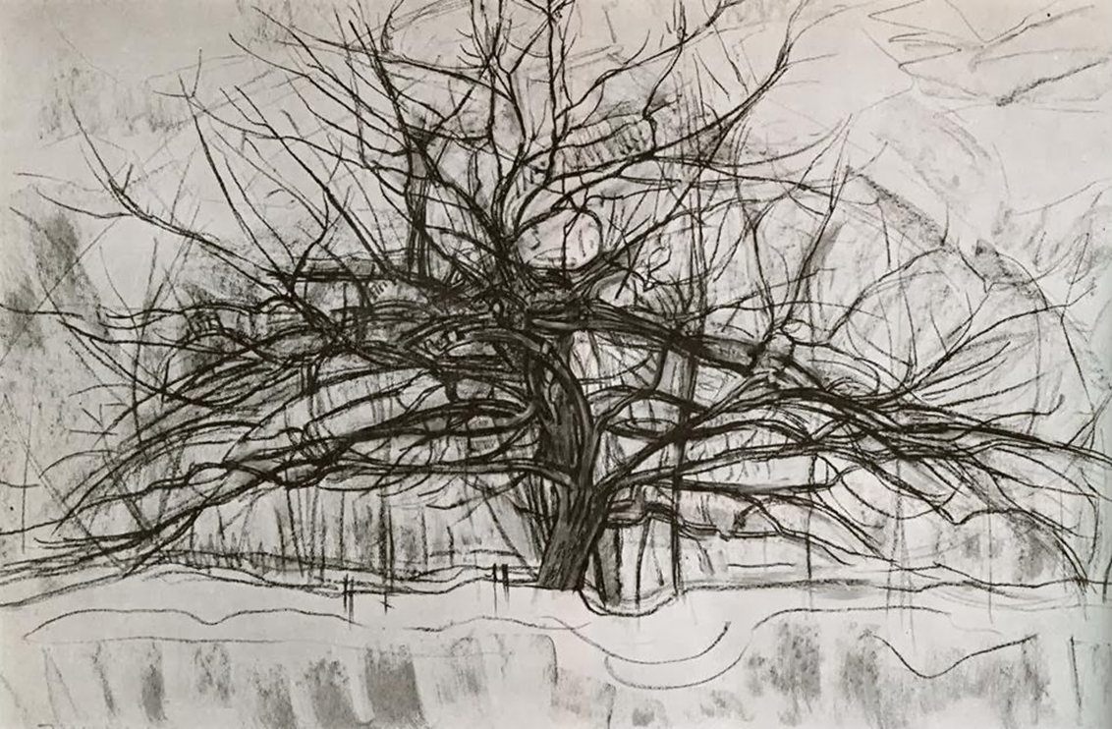
“I wish to approach truth as closely as is possible, and therefore I abstract everything until I arrive at the fundamental quality of objects."
Piet Mondrian

Slide 2
Abstracted transformation from an observed model
Asymmetrical Balance- a visually felt sense of equilibrium
Contrast of Value : the interpretation of light and dark ( colour/ tone )into a relative degree of black and white and the intermediate greys
Thumbnails

Slide 3
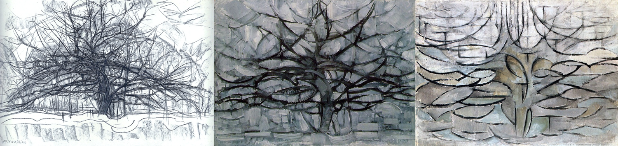
Abstracted transformation and reduction
Piet Mondrian

Slide 4
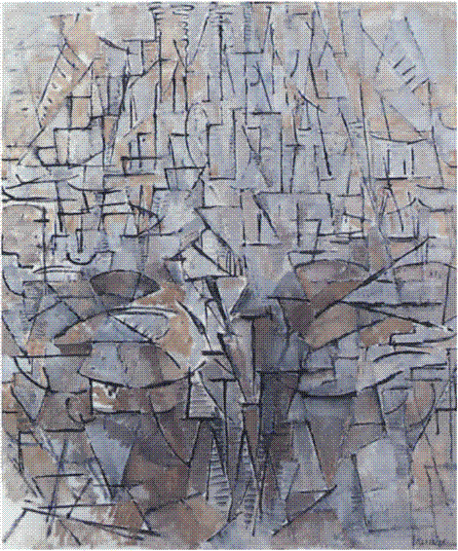
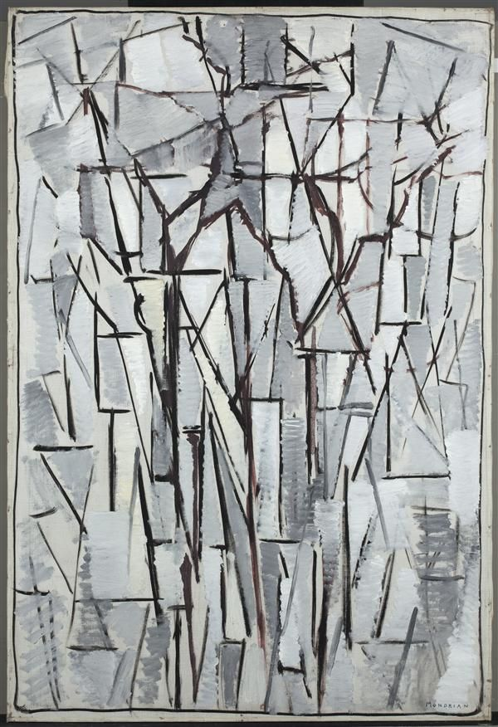

Low Contrast
Piet Mondrian

Slide 5
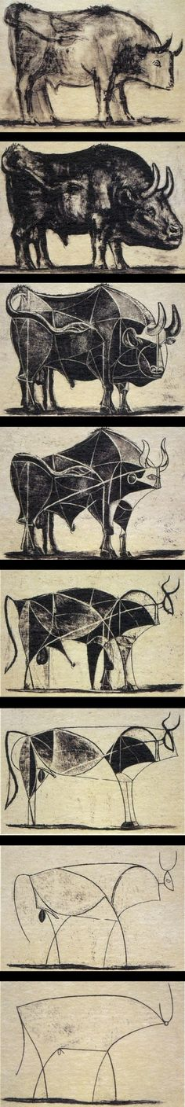
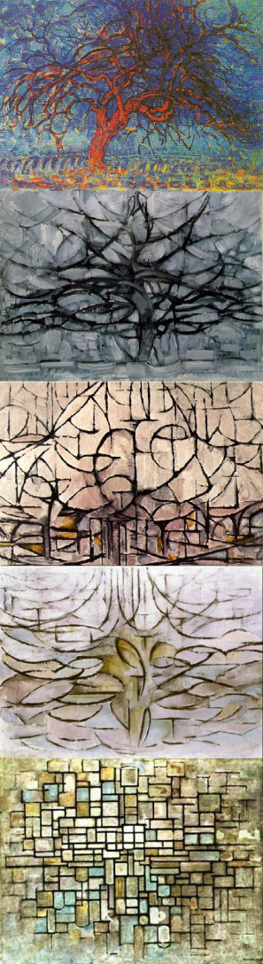
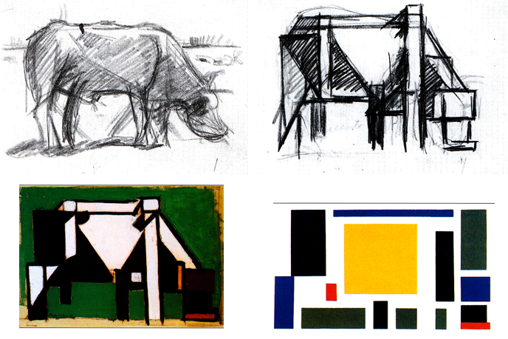
Theo van Doesburg
Mondrian
Picasso

Slide 6
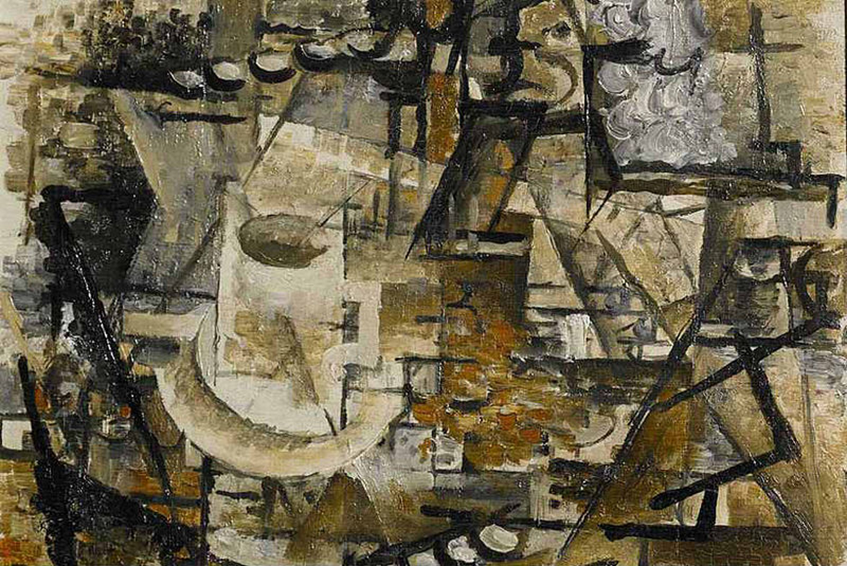
Medium to low contrast with focal point
Georges Braque

Slide 7
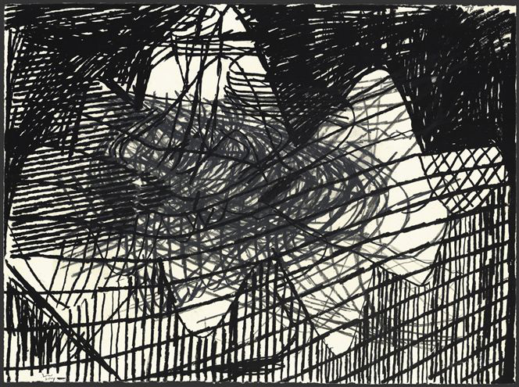
High contrast
Terry Winters

Slide 8
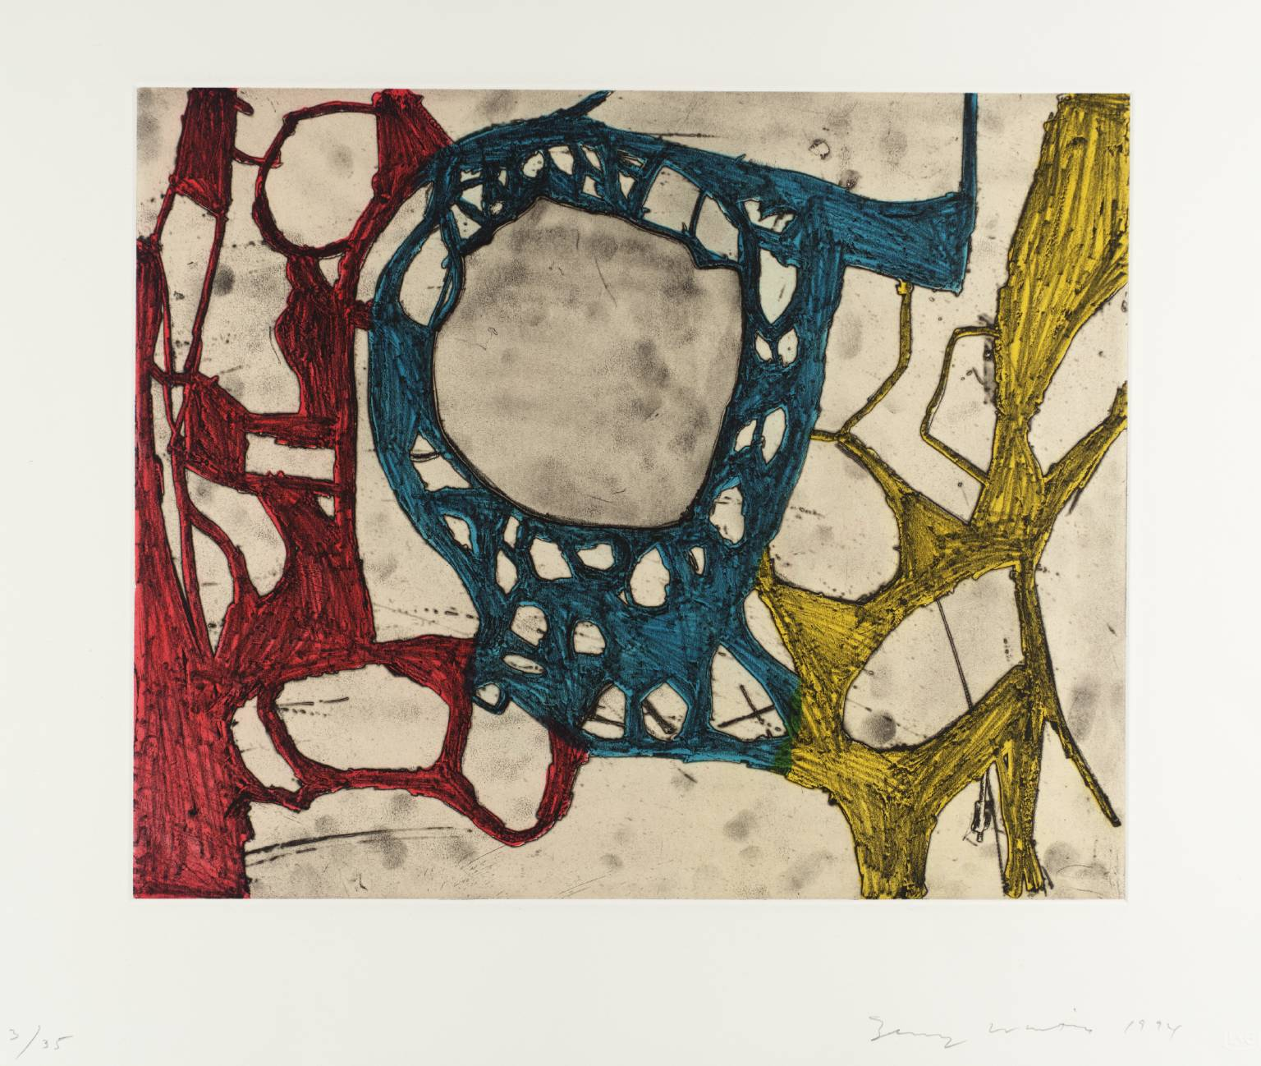
Medium contrast , Focal point
Terry Winters

Slide 9
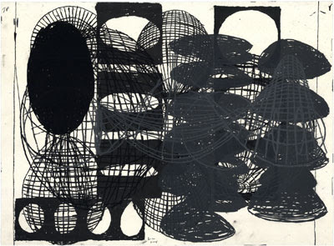
Terry Winters
High Contrast

Slide 10
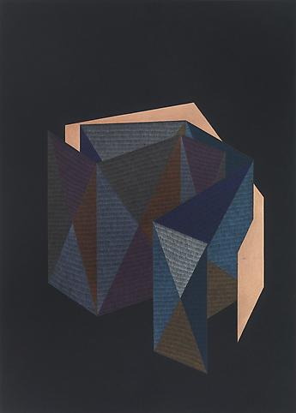
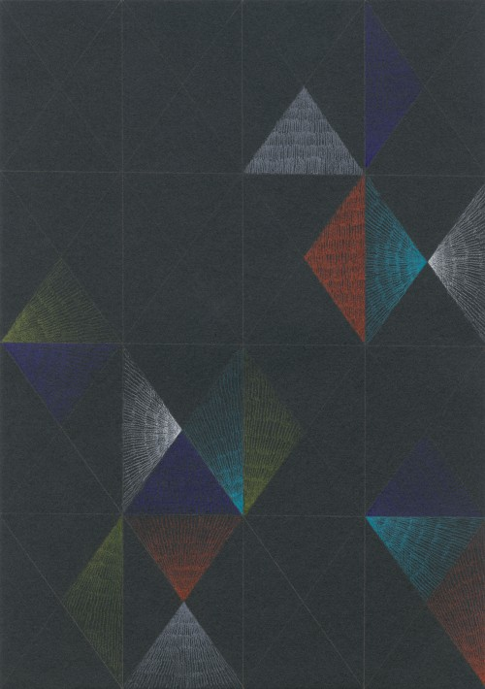
Low contrast – High contrast Focal point
Low Contrast
Claudia Wiser

Slide 11
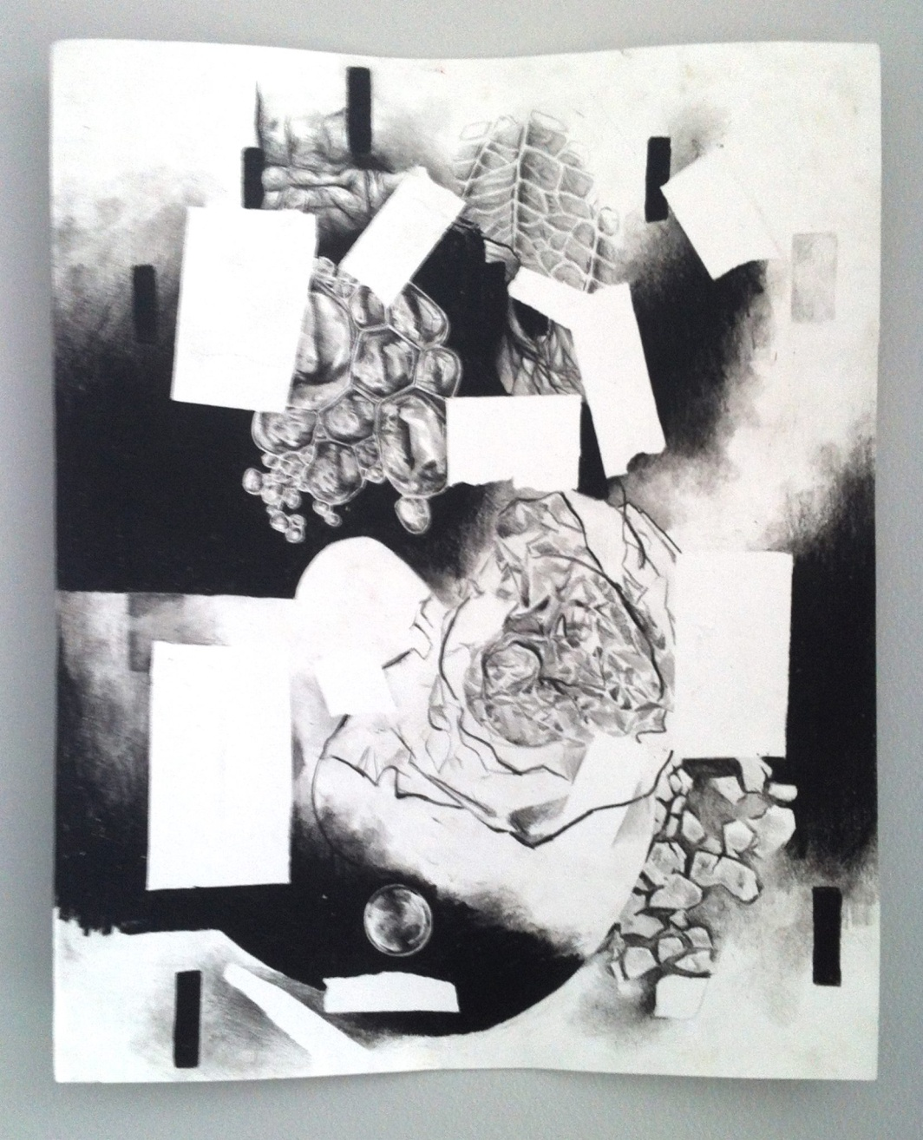
High Contrast, all over eccentric

Slide 12
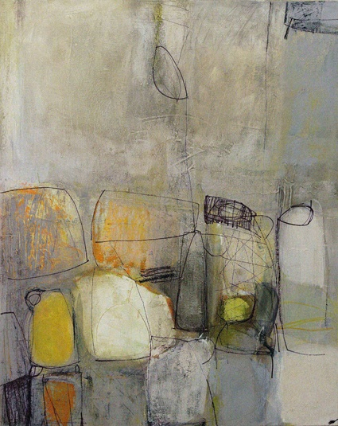
Desaturated colour – Contrast of value, low contrast
Conrad Marca-Rielli

Slide 13
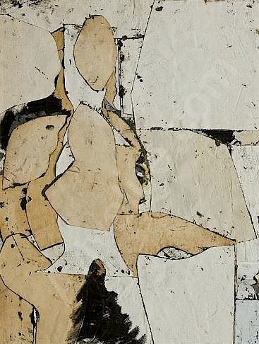
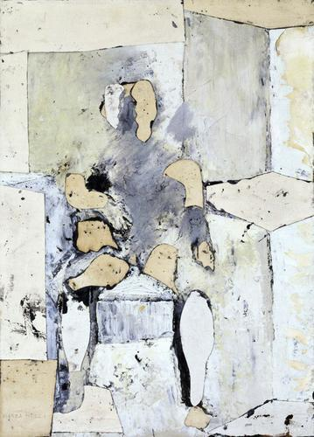
Low contrast- chromatic whites
Conrad Marca-Rielli

Slide 14
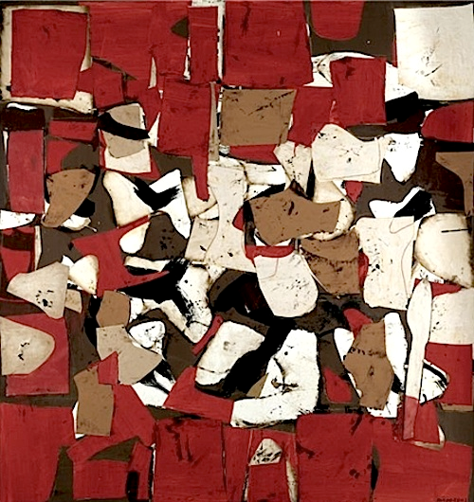
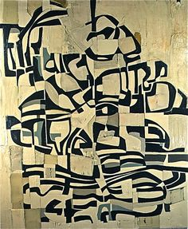
Conrad Marca Rielli
Contrast of intensity : High contrast between colour and neutrals – figure and ground

Slide 15
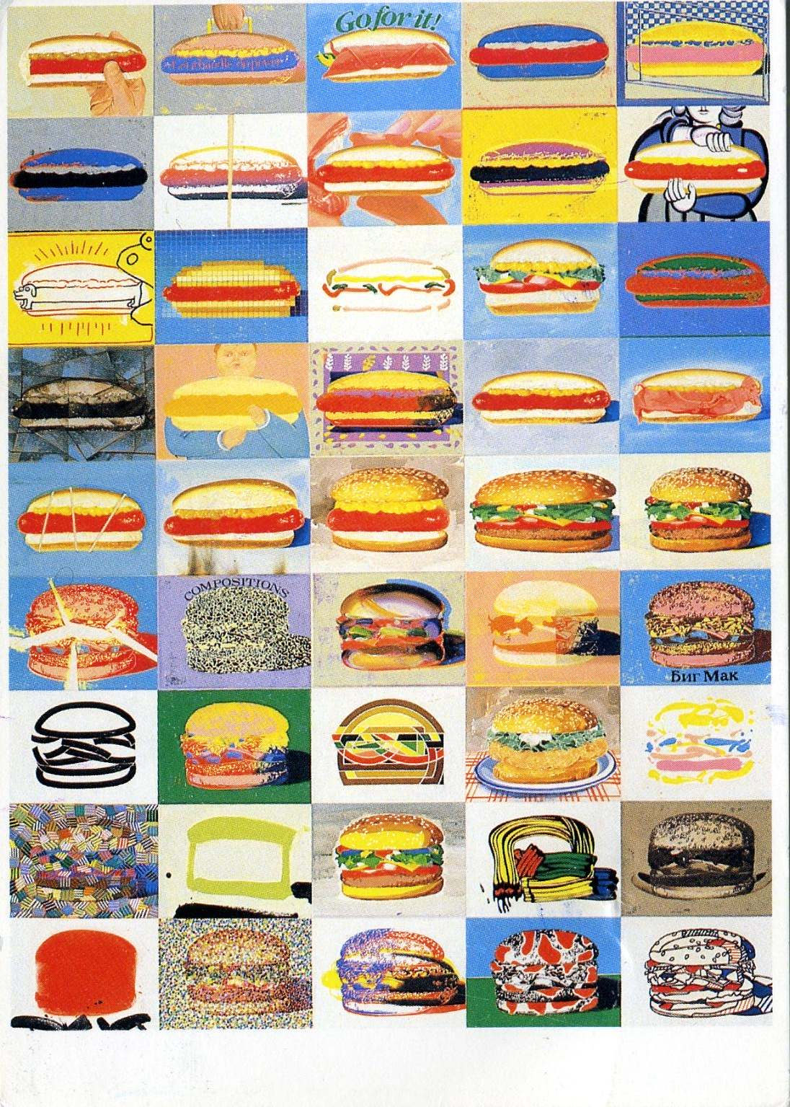
Paul Giovanopoulos
Grid structure formal order.

Slide 16
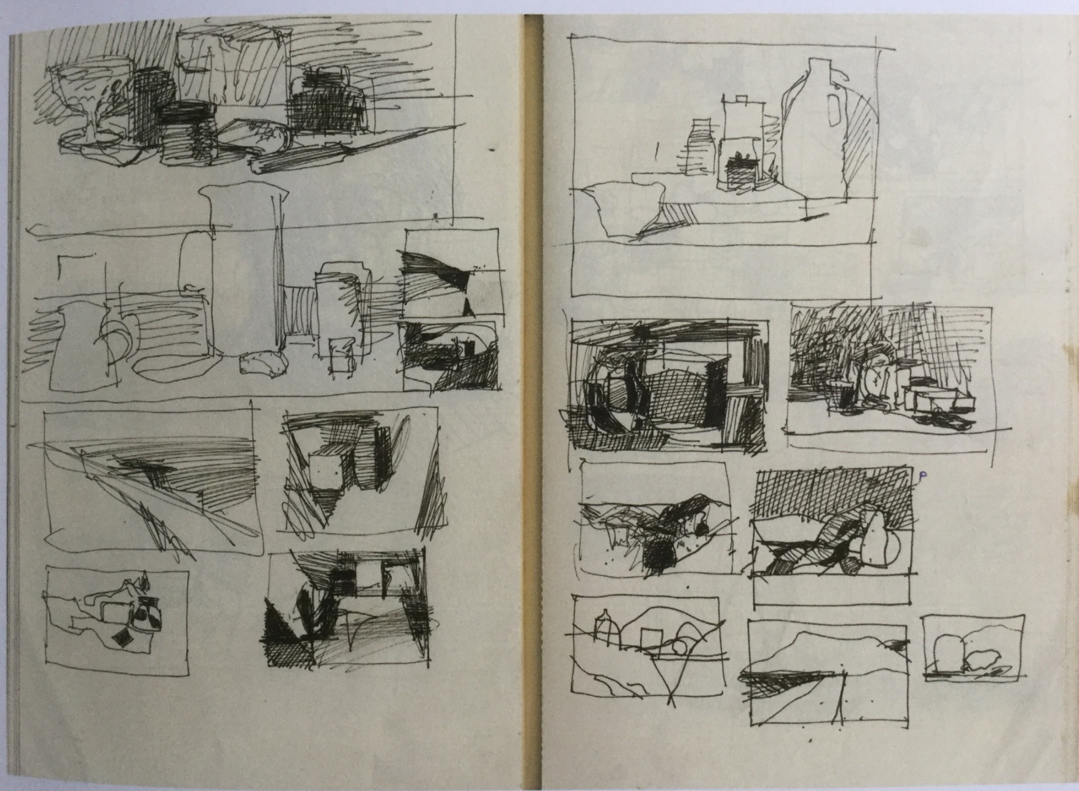

Thumbnails studies

